Slide 1
Opportunity Hack: National Center for Missing and Exploited Children
Connor Segneri
Michael Ryan
Joshua Lee
Tommy Fowler

Slide 2

The Challenge
The National Center for Missing and Exploited Children is the only non-profit agency to track abductions nationwide.
They were looking for a way to quickly analyze
their two datasets: missing children and confirmed
attempted abductions.

Slide 3
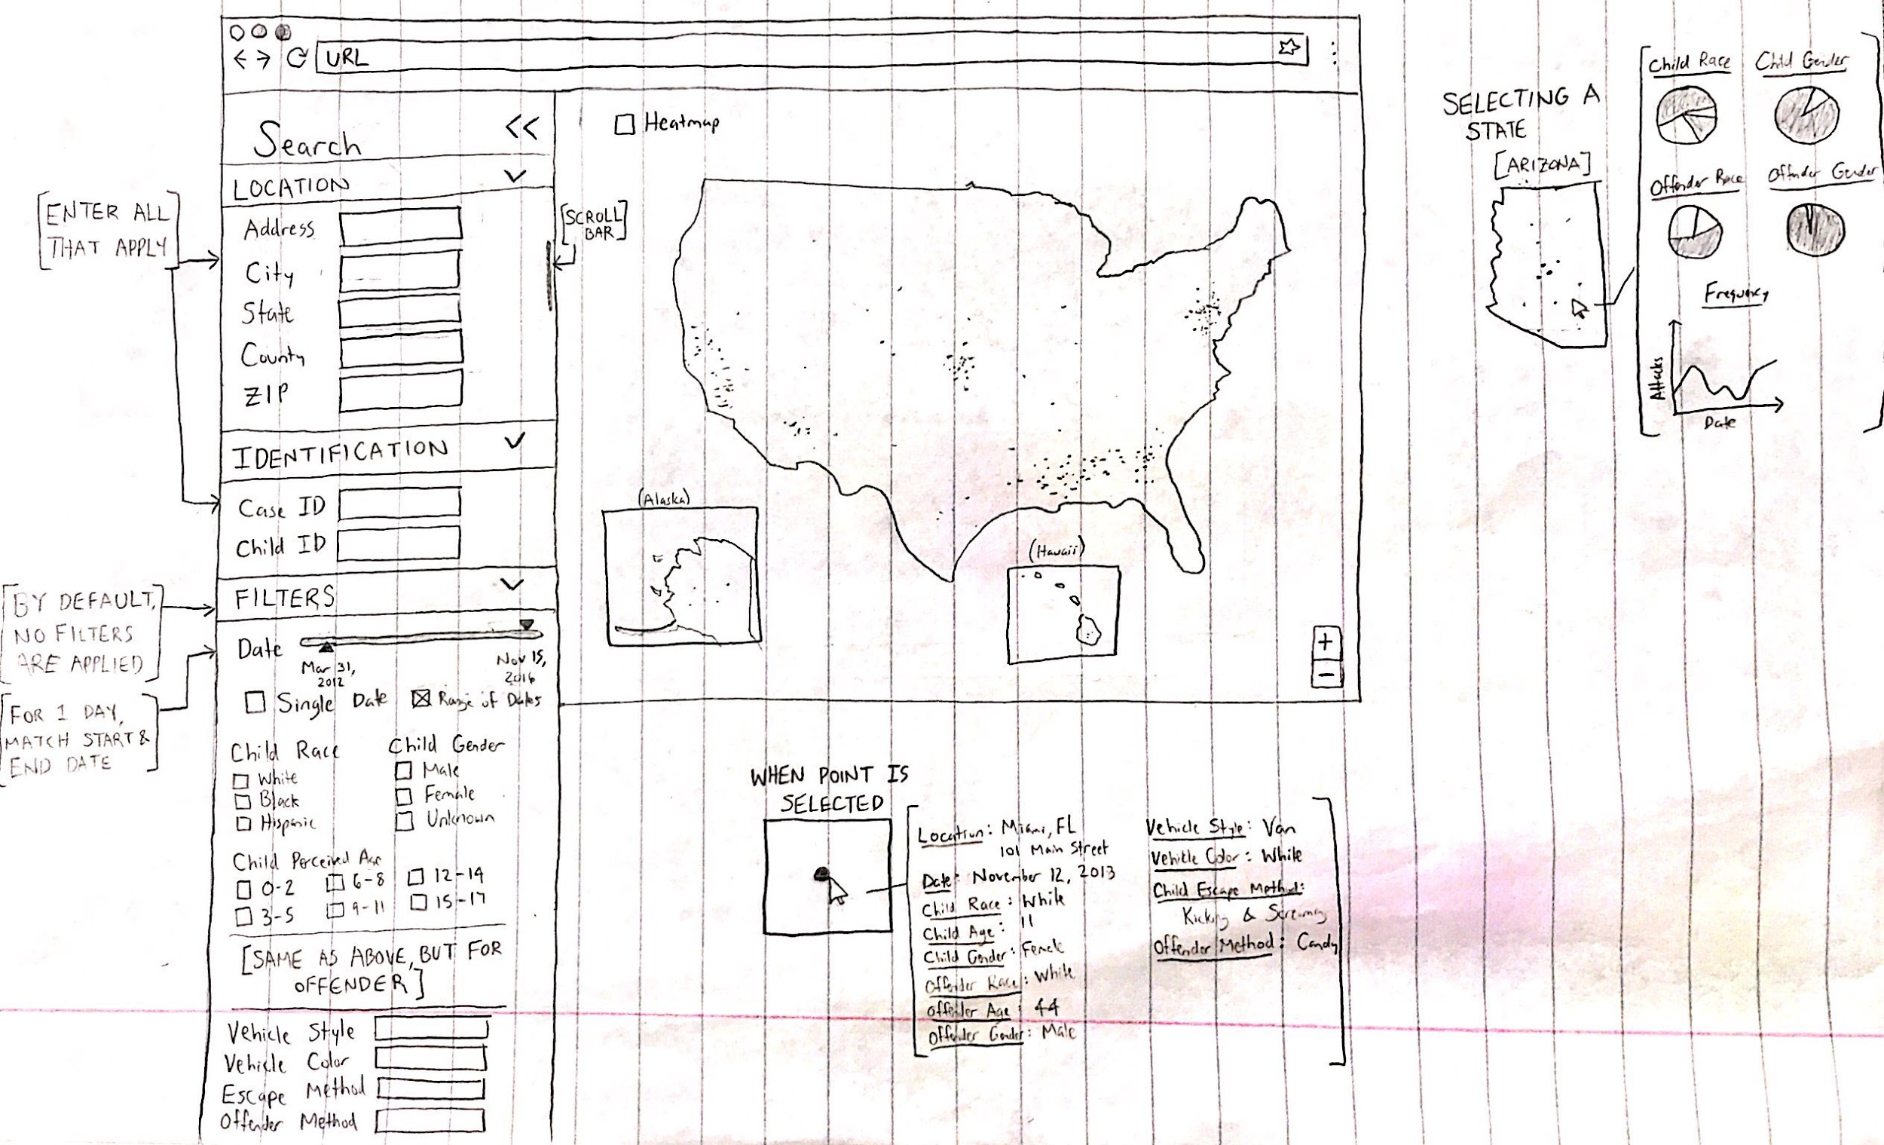
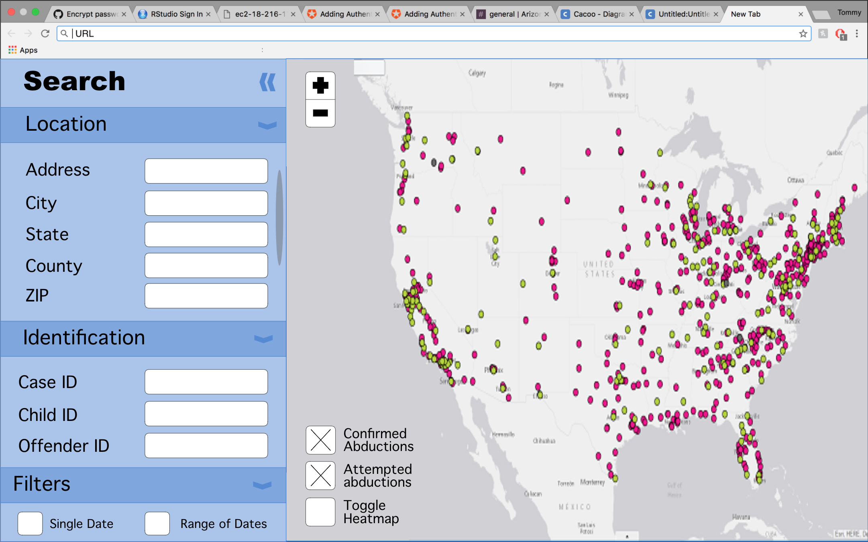
Initial Designs

Slide 4





Tools We Used

Slide 5
Final Product

Slide 6
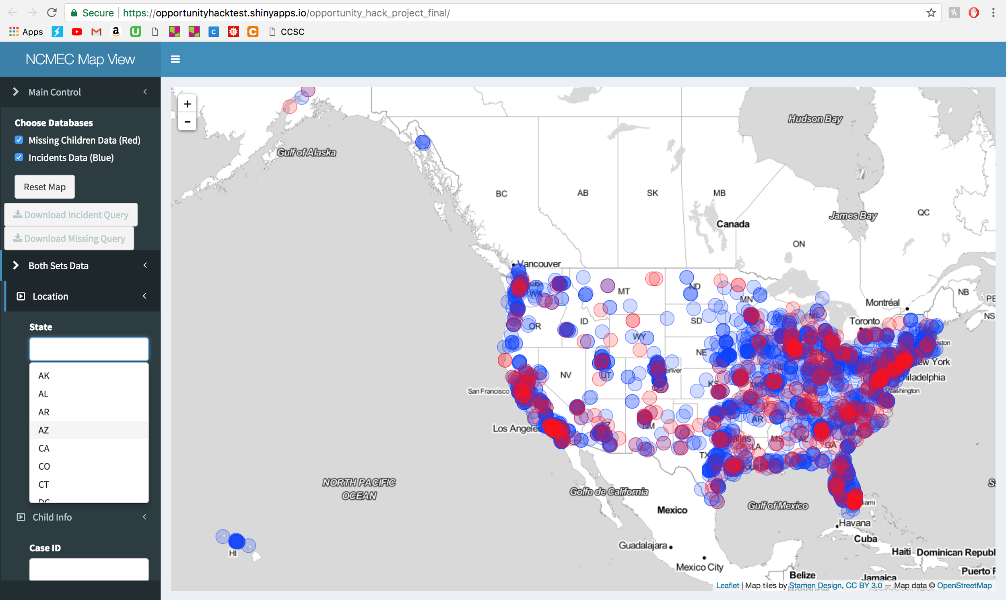

Slide 7
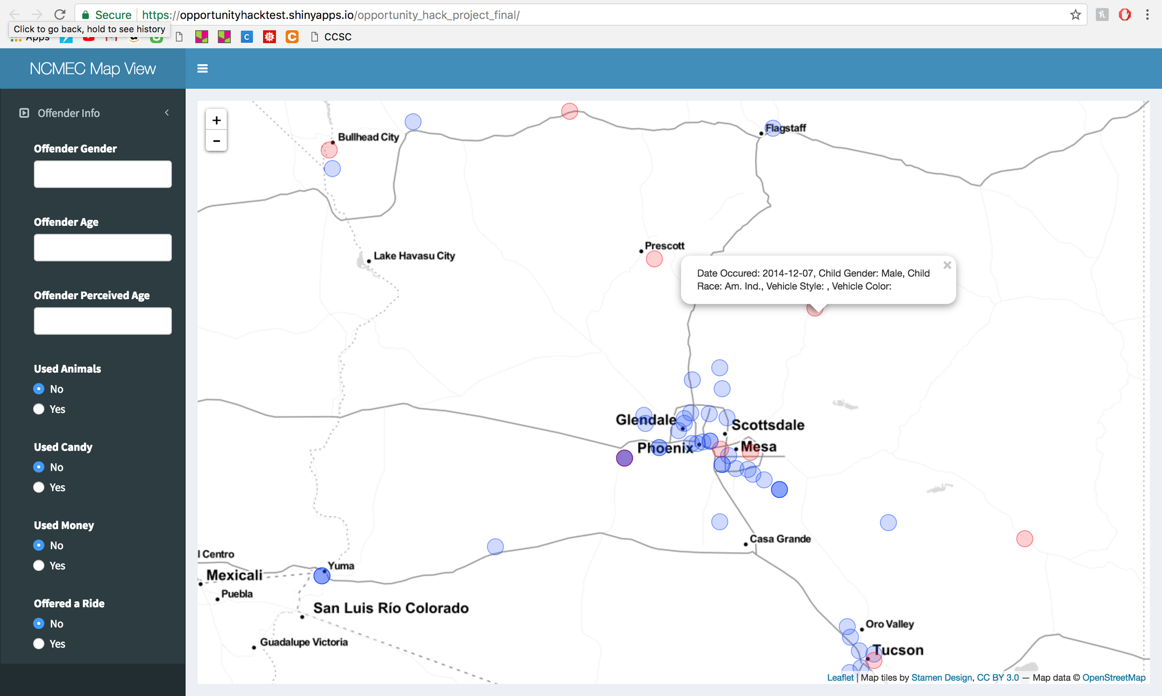

Slide 8
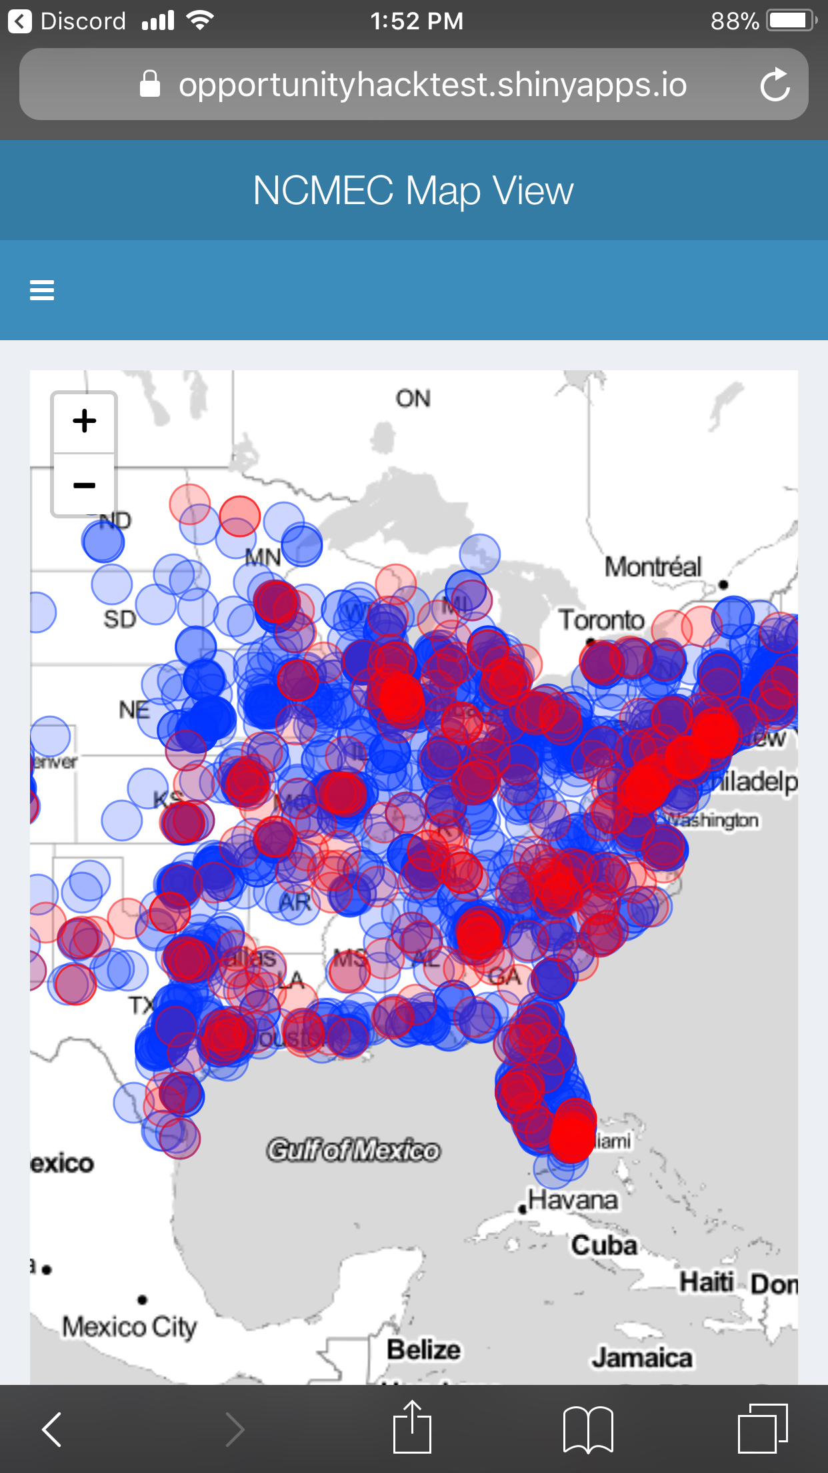
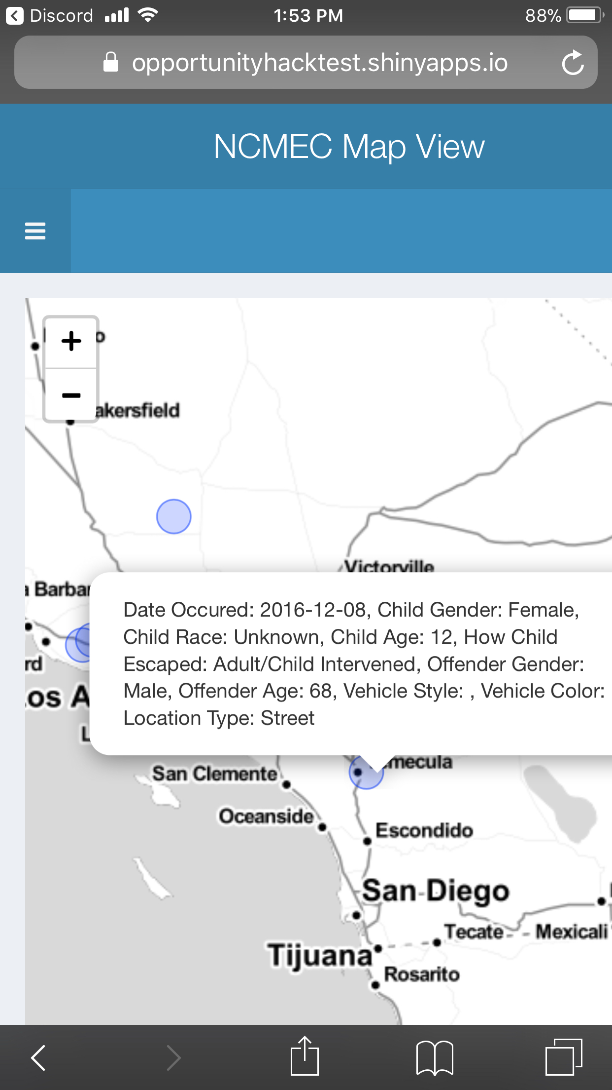

Slide 9
Thank you to all the sponsors and non-profits involved!

